Slide 1
Bayesian Uncertainty Quantification in Direct Reaction Theory
Amy Lovell
Michigan State University and
National Superconducting Cyclotron Laboratory
In collaboration with:
Filomena Nunes (MSU/NSCL)
York, United Kingdom
November 6, 2017
Notes:
Thank you. Today I’m going to be talking to you about some of my thesis work that I’ve been doing with my adviser, Filomena Nunes, in quantifying uncertainties in few-body reaction theory. Before I talk about our results, I’m going to give some motivation about why we should even care about reaction theory (although I’m sure this will not be news to anyone here) and why we need to understand our uncertainties.

Slide 2
Uncertainty Based on Fitting in Single Nucleon Transfer
d + A
(A+1) + p or (A+1) + n
Working under the assumption that the model is known.
The uncertainty only comes from the optical potential.
A.E. Lovell and F.M. Nunes J. Phys. G 42 034014 (2015)
Notes:
What we’ve started to tackle is quantifying the uncertainties that come from the fitting of data. Often, when we want to do a reaction calculation, we fit our model to elastic scattering data and then use that fitted potential as the input to some other calculation (elastic, breakup, transfer, etc.). However, there is a lot of uncertainty in this. Even for parameterizations that produce similar elastic scattering, the resulting transfer, for example, calculations can be very different. And may not even describe the data. We are going to be quantifying this by assuming that the model is known and the uncertainty only comes from the fitting.

Slide 3
Optical Model Parameterizations
Parameters enter the model in the potential between the nuclei
Using the Optical Model
Volume Term
Surface and Spin-Orbit Terms
≈ 6-12 free parameters
I.J. Thompson and F.M. Nunes, Nuclear Reactions for Astrophysics, (Cambridge University Press, Cambridge, 2009)
Notes:
We are interested in quantifying the uncertainties that are being introduced through fitting to elastic scattering data. The free parameters in our model enter through the potentials describing the interactions between nuclei – target and projectile. In this work, we use the optical model, which has real and imaginary terms, where the imaginary part of the potential takes into the account the flux that leaves which is not explicitly defined in the model. Here, we focus on the volume, surface, and spin-orbit terms (although, depending on the description of the problem, we could of course have tensor forces, etc. etc.). They are taken to have a Woods-Saxon shape (or derivative) and are parameterized by a depth, radius, and diffuseness. The number of free parameters within the model can add up very quickly – especially when these other terms are added – however, for this work, we only focus on the real and imaginary volume terms and the imaginary surface term, 9 free parameters.

Slide 4
Reactions Using the Adiabatic Wave Approximation (ADWA)
Full three-body wave function
Adiabatic approximation
Explicitly takes into account the breakup of the deuteron – through nucleon-target potentials
Elastic scattering
Breakup components
I.J. Thompson and F.M. Nunes, Nuclear Reactions for Astrophysics, (Cambridge University Press, Cambridge, 2009)
Notes:
The first is the adiabatic wave approximation (or ADWA). This formulation for the transfer reaction explicitly takes into account the breakup of the deuteron in the field of the target through nucleon-target interactions (instead of considering the deuteron-target interaction). We solve the schrodinger equation for the adiabatic 3-body wave function which is a sum of deuteron states and deuteron-target scattering states. This sum contains the elastic scattering components and then the break up components.

Slide 5
Constraining Nucleon Potentials A(d,p)B
Incoming channel
Outgoing channel
d(n+p) + A
B(A+n) + p
Notes:
To formulate the transfer cross section, we need to calculate the (d,p) T-matrix. Each piece of the T-matrix is constructed from an interaction in either the incoming or outgoing channel. The deuteron interaction, the nucleon-target interactions – lead to the distorted wave for the deuteron – the bound state of the transferred neutron (or proton), and the proton scattering state. The distorted waves are for the deuteron and proton are constructed through the nucleon optical potentials and these are what we can constrain with elastic scattering data. At the moment we fix the deuteron interaction and the potential that gives rise to the nucleon bound state.

Slide 6
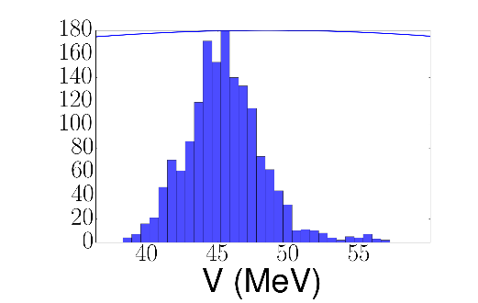
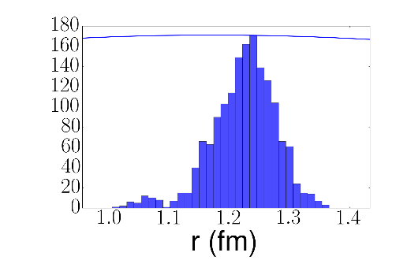
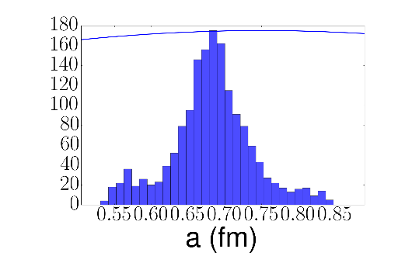
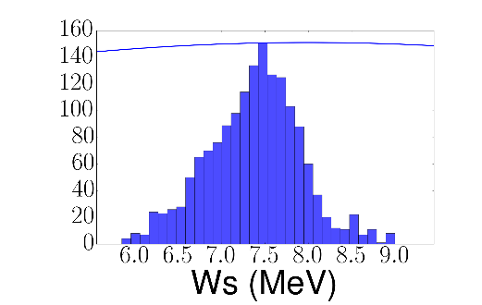
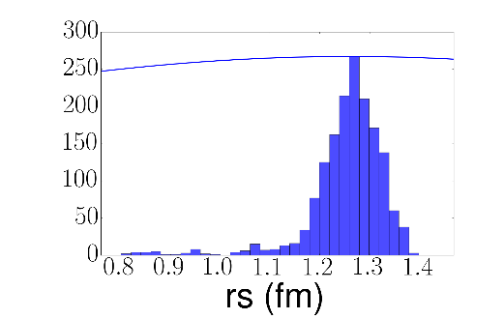
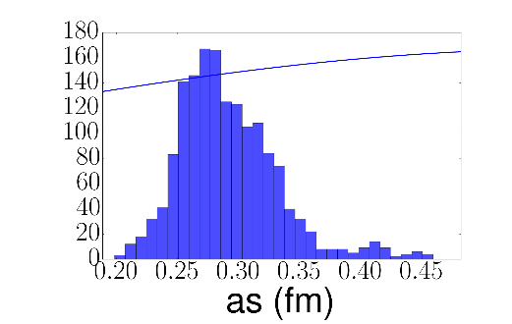
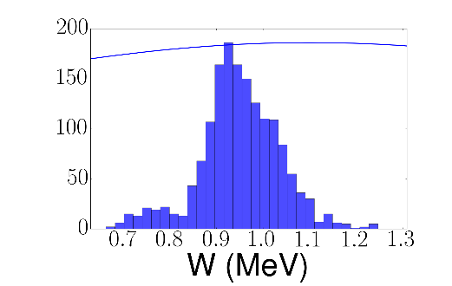
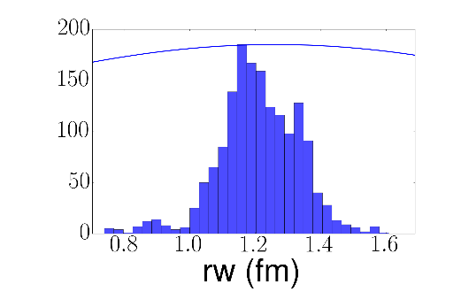
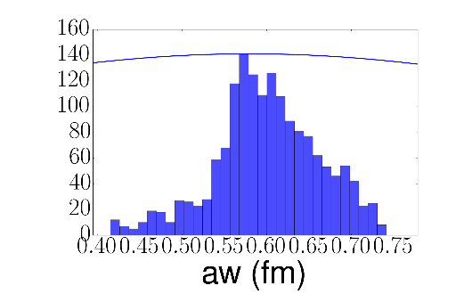
⁴⁸Ca(n,n) at 12.0 MeV Posterior Distributions
Real Volume
μ=45.51
σ=2.74
1.22
0.05
0.68
0.06
Imaginary Surface
7.38
0.54
1.25
0.08
0.29
0.04
Imaginary Volume
0.95
0.09
1.21
0.12
0.60
0.06
Notes:
First we look at the posterior distributions that we get using 12C(n,n) elastic scattering at 12.0 MeV. They are compared to the prior distribution – solid line, and we have them for the real volume, imaginary surface, and imaginary volume terms, depth, radius, and diffuseness. Since they’re hard to see, I list the mean value and standard deviation for each distribution. The distributions are all centered around physical values and are relatively well constrained.

Slide 7
⁴⁸Ca(n,n) at 12.0 MeV Angular Distribution
Bands define a 95% confidence interval
Data from: Phys. Rev. C 83 064605 (2011)
Notes:
We can then calculate the 95% confidence intervals for the elastic scattering cross section using these posterior distributions. They are fairly well constrained and reproduce the data well – which they should since we’re essentially fitting to the data.

Slide 8
Constructing Transfer Cross Sections
Constrained from ⁴⁸Ca(p,p) @ 25.0 MeV data
Constrained from ⁴⁸Ca(p,p) @ 14.03 MeV and ⁴⁸Ca(n,n) @ 12 MeV data
Posterior distributions are then used to construct PREDICTED distributions for the transfer reaction
Notes:
Now, we need to construct our transfer cross section which we calculate from the T-marix. The bound states were fixed, and we construct our scattering states from the optical potentials that were constrained by nucleon scattering data. The posterior distributions that were calculated from the elastic scattering can then be fed into the cross section calculation to construct a predicted posterior distribution for the transfer reaction.

Slide 9
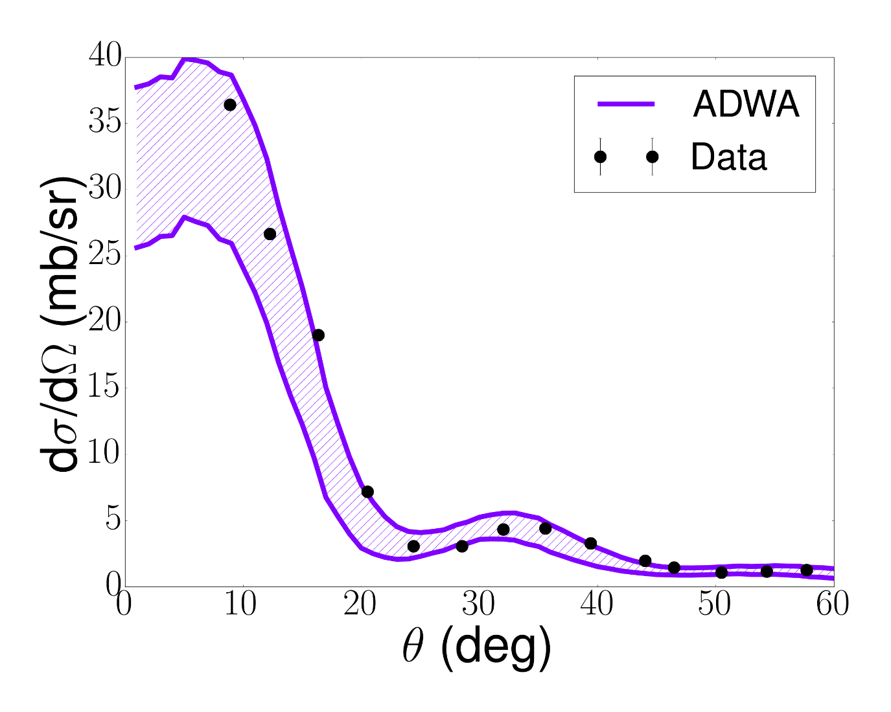
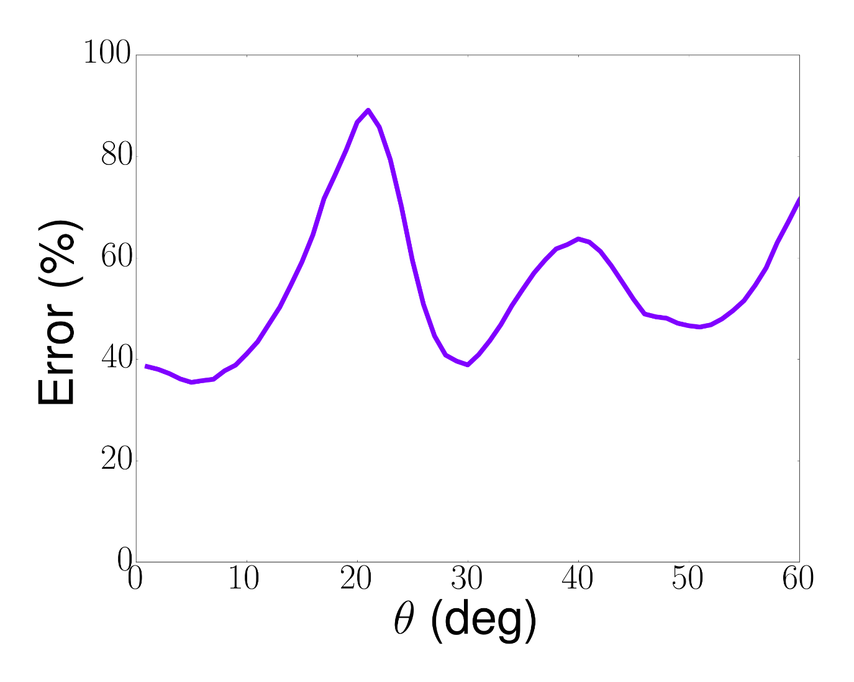
⁴⁸Ca(d,p)⁴⁹Ca(g.s.) at 24.0 MeV in ADWA
Data at 19.3 MeV
Data extracted from: A.M. Mukhamedzhanov, F.M. Nunes, and P. Mohr, PRC 77 051601 (2008)
Notes:
This is shown here – 48Ca(d,p) transfer to the ground state at 24 MeV – compared to data at 19 MeV to show that the shape is reasonable. Even though all of our elastic cross sections were relatively well constrained, the width of the 95% confidence intervals for the transfer are rather broad. We can quantify this by calculating a percent error at each angle, defined by the width of the 95% interval divided by the mean value of the cross section at that angle. This is shown to the right. The uncertainty oscillates wildly, jumping at minima in the angular distribution. At the peak, where we would extract a SF for example, this error is about 35%.

Slide 10
Distorted Wave Born Approximation (DWBA)
ADWA
DWBA
DWBA does not explicitly take into account the breakup of the deuteron and is generally considered a more simplistic theory
I.J. Thompson and F.M. Nunes, Nuclear Reactions for Astrophysics, (Cambridge University Press, Cambridge, 2009)
Notes:
We also want to begin to rigorously compare different reaction models. To do this, the second model that we consider is the distorted wave born approximation (DWBA). This is also an approximation to the true three-body wave function but it does not explicitly take into account the breakup of the deuteron, as the adiabatic model does. It models the three-body wave function just as the deuteron bound state and the deuteron-target distorted wave – so it takes into account the optical potential between the deuteron and target (instead of nucleon-target).

Slide 11
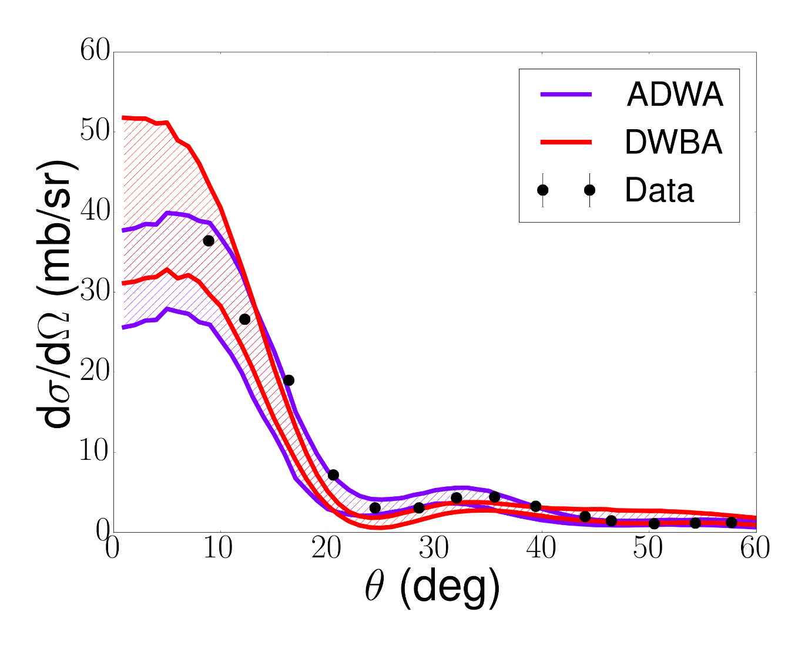
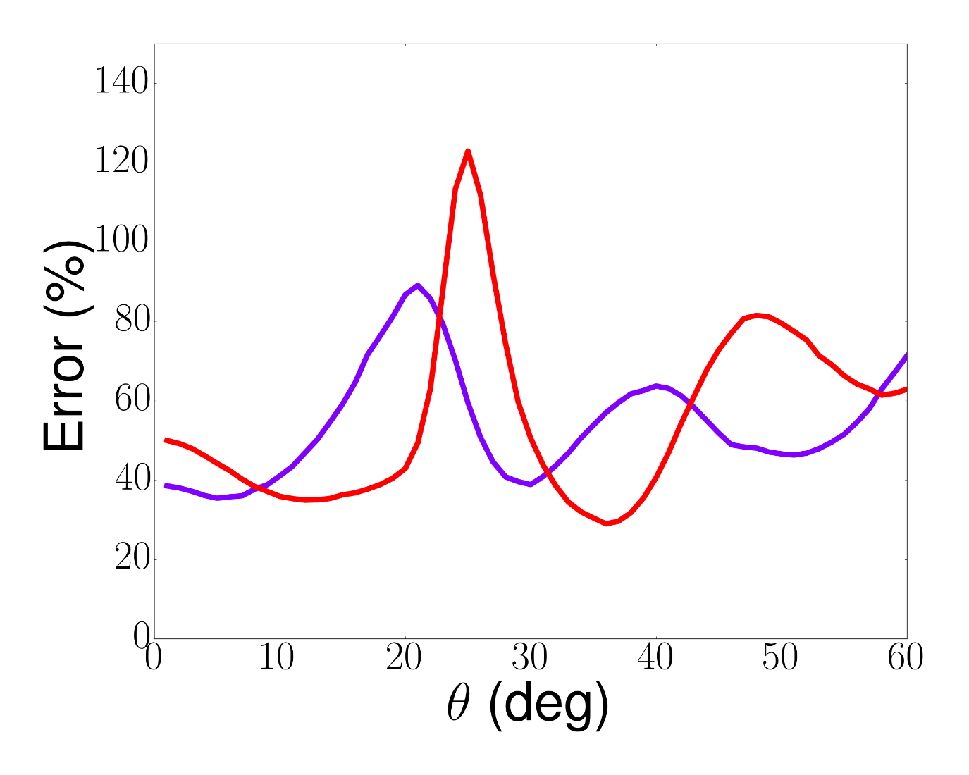
Comparison Between ADWA and DWBA ⁴⁸Ca(d,p)⁴⁹Ca(g.s.)
Data extracted from: A.M. Mukhamedzhanov, F.M. Nunes, and P. Mohr, PRC 77 051601 (2008)
Notes:
Can again construct the transfer cross sections, and this time compare between the four calculations that were performed. Two adiabatic and two DWBA. The shapes are definitely different but at this point, we can’t really pick out the better calculation. We know that ADWA contains more physics (explicitly including the deuteron breakup), and we would hope that this would somehow show up beyond a direct comparison to data. As a start we can compare the percentage errors. All oscillate significantly, but at the point where we would extract some of the relevant information (peak of each xs), the adiabatic have smaller errors and the dwba calculations. However, a more rigorous formulation has to be made for this.

Slide 12
Summary and Outlook
Uncertainty quantification is being introduced into direct reaction theory
Bayesian methods have been used to constrain all optical potential parameters needed for the adiabatic wave approximation (ADWA) and the distorted-wave Born approximation (DWBA)
Although the elastic scattering is well fitted, the confidence intervals for transfer predictions are wide (~50% in the region of interest)
We also directly compare to ADWA and DWBA in terms of the predicted confidence intervals for the transfer reactions, which is leading to more rigorous model comparison (through the Bayes factor)
We can start to help in planning experiments – what is the percent error needed in the data to constrain the observables of interest (ask me more!)
With MSU undergrad, Garrett King, we can directly compare frequentist and Bayesian methods for the same reaction models (ask me more!)
Notes:
Summarize everything – essentially what’s here with some more detail

Slide 13
Acknowledgements
Filomena Nunes, Garrett King, and the few-body group (NSCL/MSU)
David Higdon (Virginia Tech)
Dick Furnstahl (Ohio State University)
iCER and HPCC (MSU) for computational resources
DOE NNSA Stewardship Science Graduate Fellowship
Thank you!
Any questions?
Notes:
Thank yous! Collaborators and the rest of my group. Dave and Dick for discussions, computational resources at MSU, as well as my wonderful fellowship (which allowed me to spend 3 months out here during the beginning of this year). (To everyone here and for being invited)

Slide 14
Backup Slides

Slide 15
Exploring Bayesian Statistics
Posterior is drawn numerically via a Markov Chain Monte Carlo
Posterior – probability that the model/parameters are correct after seeing the data
Prior – what is known about the model/parameters before seeing the data
Evidence – marginal distribution of the data given the likelihood and the prior
Likelihood – how well the model/parameters describe the data
S. Andreon and B. Weaver, Bayesian Methods for the Physical Sciences (Springer, 2015)
Notes:
There are several formulations of uncertainty quantification that can be used to constrain these parameters. Recently, we have started using Bayesian models. The general idea is that you’re trying to compute the posterior distribution which describes how well the parameterization or model that is being used describes the data. It takes into account prior information – what is known about the model or parameters before seeing the data, the likelihood which contains the comparison between the data and model (related to the chi^2 typically), as well as some marginal distribution of the data. This distribution is typically extremely difficult (or impossible) to calculate so Monte Carlo calculations are used to sample the posterior distribution.

Slide 16
Big Questions in Nuclear Physics
How did visible matter come into being and how does it evolve?
How does subatomic matter organize itself and what phenomena emerge?
Are the fundamental interactions that are basic to the structure of matter fully understood?
How can the knowledge and technical progress provided by nuclear physics best be used to benefit society?
Take from The 2015 Long Range Plan for Nuclear Science
http://science.energy.gov/~/media/np/nsac/pdf/2015LRP/2015_LRPNS_091815.pdf
Notes:
The most recent Long Range Plan for Nuclear Science identified these four broad questions for the field. [More or less state questions.] Experimental and theoretical nuclear reaction studies can dig deep into many of these questions. I will mostly touch upon the first three, but there are clearly many practical applications that can come out of studying nuclear physics as well.

Slide 17
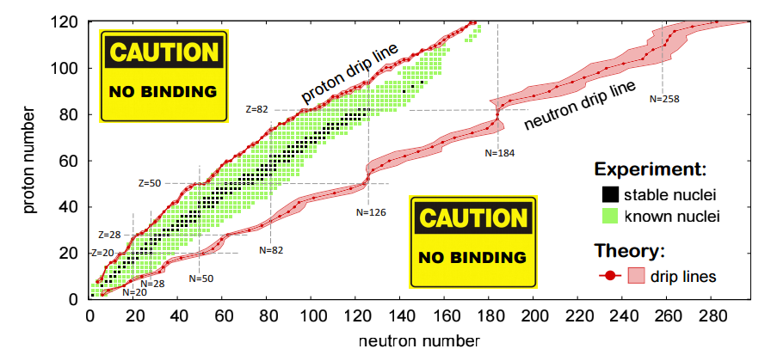
Understanding the Limits of Stability
The 2015 Long Range Plan for Nuclear Science
Notes:
Part of answering these questions comes from understanding the limits of stability – especially in understanding the interactions that govern the structure of nuclei. As you can see on the chart of the nuclides, we have the stable nuclei (black) and the rest of the known nuclei (green) compared to the predictions for the neutron and proton driplines. The bands contain all of the various calculations that have been performed to calculate the driplines, and it is important to note that, in many cases, the uncertainties in the location of the dripline is wider than some known isotopic chains.

Slide 18
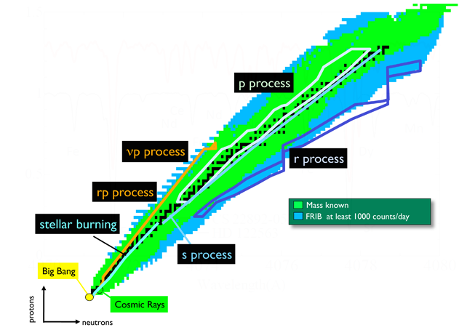
Understanding the Nuclear Abundances
Many processes are well known
Nuclei involved can be studied directly
Other nuclei will be only be produced when FRIB comes online (r-process nuclei)
These systems are more neutron rich and farther from stability
Need indirect measurements to study these systems
http://www.int.washington.edu/PROGRAMS/14-56w/
Notes:
To better understand the formation of the cosmos, we want to understand the abundance of each element. Many different processes create the known nuclei, from well understood processes such as stellar burning and the p-process (proton capture?) to less well known processes such as the r-process which produces neutron-rich nuclei. In order to study these nuclei, we must produce them in the lab – to study the properties that go into astrophysics calculations. Many of the systems that are of interest are far from stability (r-process), and are not able to be measured directly. Sound reaction theory is crucial for then extracting relevant quantities, especially when dealing with measurements in inverse kinematics or with surrogate reactions.

Slide 19
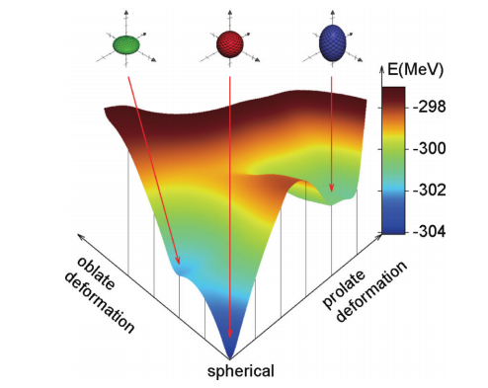
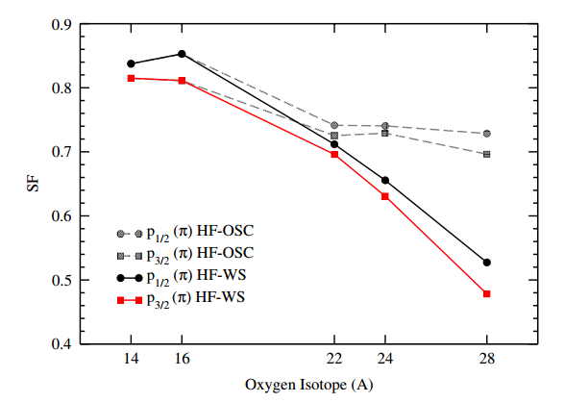
Understanding Properties of Nuclei
What is the internal configuration of nucleons?
How are nuclei shaped?
Hartree-Fock calculation for ⁶⁸Ni
S. Suchyta, et. al., PRC 89 021301(R) (2014)
How does the structure of nuclei change away from stability?
Can be probed using reactions
O. Jensen, et. al., PRL 107 032501 (2011)
Notes:
There are many properties of nuclei that we are interested in learning about. What are the interactions between nuclei and nucleons? How do these interactions change between stable and unstable systems? Do nuclei behave the same way if they’re created by different methods? What sorts of internal structures form in nuclei? How are they shaped? All of these types of questions can be probed by studying nuclear reactions.

Slide 20
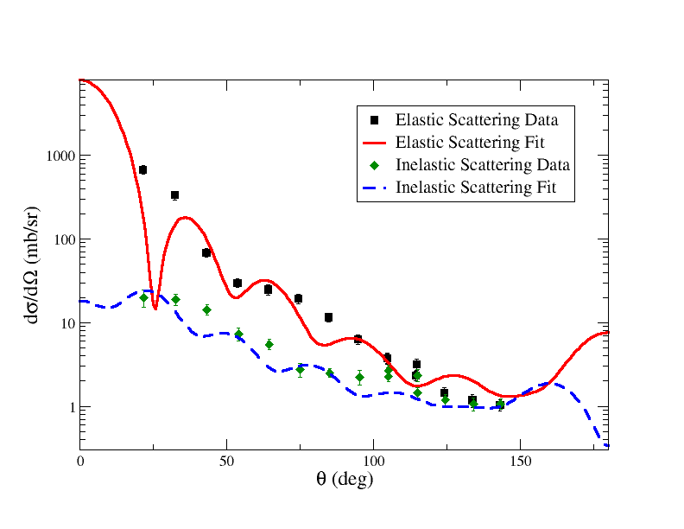
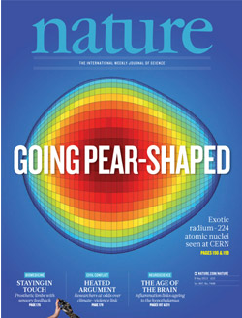
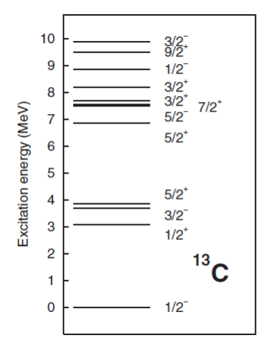
Elastic and Inelastic Scattering
Elastic Scattering
¹²C(n,n)¹²C and ¹²C(n,n*)¹²C(2⁺₁) at 28 MeV
Initial and final states are the same
*
Inelastic Scattering
Final system left in an excited state of the initial system
Notes:
Elastic scattering, with the same initial and final states, can give us information about the interactions of nuclei – including the shape and strength of the nuclear potential. Inelastic scattering (where the final state is left in an excited state) can tell us about the deformation of a nucleus, as well as give information about the strength of transitions between states within the nucleus.

Slide 21
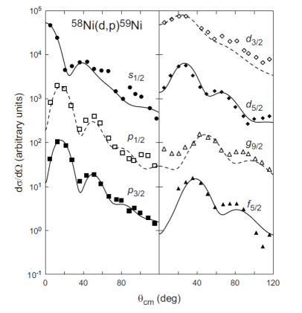
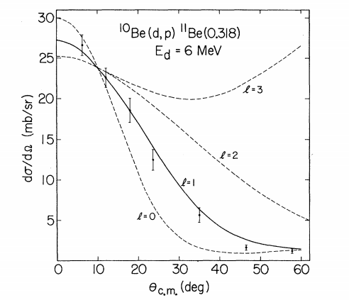
Single Nucleon Transfer Reactions
Transfer reactions can give information about the states that are being populated
⁵⁸Ni(d,p)⁵⁹Ni
@ 8 MeV
¹⁰Be(d,p)¹¹Be @ E_{d} = 6 MeV
D.R. Goosman and R.W. Kavanagh, PRC 1 1939 (1970)
Isotope Science Facility, white paper (2007)
Notes:
Transfer reactions can be used to probe specific states in nuclei. I’m going to be talking specifically about single-nucleon transfer reactions, but cluster transfers can also give a lot of information about the systems being studied – alpha transfer gives information about alpha clustering within a system. Single-nucleon transfer, however, for instance, if a deuteron impinges on a target and transfers a neutron to the target, leads to information about the single particle states that are being populated. The state that the neutron ends in is dependent on the angular momentum that was transferred during the reaction, letting us learn about those states. The cross section of a reaction will depend on the angular momentum transferred – seen by the nickel isotopes. As higher angular momentum states are populated, the first peak shifts away from zero degrees. In general, for systems that cannot be described in a simple single-particle picture, we can learn about the mixing of states by decomposing the calculated cross sections into partial wave components. Allows us to see the strength of the distribution.

Slide 22
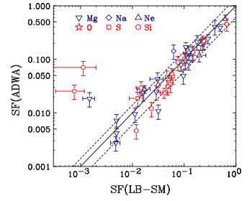
Learning About the Single Particle States in Nuclei
Calculating spectroscopic factors – probability that a composite nucleus looks like a core plus valence nucleon in a certain configuration
SF (exp)
¹⁰Be(d,p)¹¹Be @ Ed = 6 MeV
D.R. Goosman and R.W. Kavanagh, PRC 6 1939 (1970)
M.B. Tsang, et. al., PRL 102 062501 (2009)
SF (theory)
Notes:
Further more to learn about single particle states within a nucleus – and how good the single particle definition is, we can extract a SF – which is the probability that a composite nucleus looks like a core plus valance in a certain configuration. This is extracted from an experimental cross section by comparing the peak of the transfer cross section to a calculated cross section within a certain model. These can also be computed theoretically as the overlap between the A and A+1 states, and then the two SF’s can be compared. The thing is, all of this information is model dependent since it is inherently connected to an underlying theory. So understanding our theory – and the uncertainties introduced by a given formulation, simplification, parameterization, etc. is CRUCIAL.

Slide 23
Single Channel Elastic Scattering
Connecting the theory inputs to outputs that can be compared with experiment causes a highly non-linear problem
Connect to the scattering boundary conditions through the R-matrix
Theoretical angular distributions can be compared to experiment but connecting back to the potential is not trivial
I.J. Thompson and F.M. Nunes, Nuclear Reactions for Astrophysics, (Cambridge University Press, Cambridge, 2009)
Notes:
The problem, is that this is difficult. For example, if we take a simple case of single channel elastic scattering and we want to follow the parameters from the potential to the observable cross section, this not straight-forward. We numerically solve for the wave function within the range of the scattering potential which is then connected to the outgoing scattering boundary conditions through the R-matrix. However, it is the S-matrix which is a rearrangement of the R-matrix, that is introduced into the calculation for cross section calculation – which is then compared to data. We can make this connection, but it is not trivial, and it is hard to tell, a priori, how changes in the potential will affect the resulting cross sections.

Slide 24
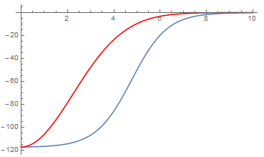
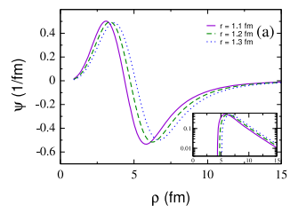
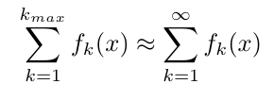
Types of Uncertainties in Reaction Theory
Systematic Uncertainties
Statistical Uncertainties
Shape of the potential
Constraints on parameters
r (fm)
V (MeV)
Model simplification
Convergence of functions
A.E. Lovell and F.M. Nunes J. Phys. G 42 034014 (2015)
Notes:
There are several places where uncertainties are introduced within our models. These can be broadly categorized into systematic uncertainties which depend on the model itself, and statistical uncertainties which we can in principle reduce by having more or better data or using larger model spaces. These include the shape of the interaction that is used, any model simplification that is introduced (freezing out degrees of freedom), the specific parameterization used, and model space truncations.

Slide 25
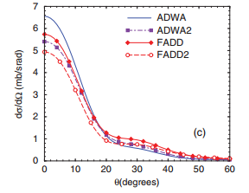
Previously Exploring These Errors
Systematic Uncertainties
Statistical Uncertainties
Constraints on parameters
⁴⁸Ca(d,p)⁴⁹Ca and ¹³²Sn(d,p)¹³³Sn
Model simplification
A.E. Lovell and F.M. Nunes J. Phys. G 42 034014 (2015)
¹²C(d,p)¹³C at E_{d}=56 MeV
F.M. Nunes and A. Deltuva, PRC 84 034607 (2011)
Notes:
Many of these have been explored previously. Studies have been performed using the same reaction with different reaction models, such as the comparison between an adiabatic formalism and a full three-body model – can directly compare the shape and magnitude of the cross sections. The same is done with the parameterization of the potentials, where we have calculated percentage errors based on the difference between two optical model parameterizations. However, this does not give us a systematic way to quantify these uncertainties – it’s always a comparison. This systematic quantification is what my thesis work has been focusing on and what I’ll tell you about today.

Slide 26
Markov Chain Monte Carlo
Using a Metropolis-Hastings Algorithm, where each parameter’s step is drawn independently from every other parameter and has a fixed size
Begin with an initial set of parameters, set the prior, p(H_{i}), and calculate the likelihood, p(D|H_{i})
Randomly choose a new set of parameters, set the prior, p(H_{f}), and calculate the likelihood, p(D|H_{f})
Check the condition:
If the condition is fulfilled, accept the new set of parameters and use these as the initial parameter set
Otherwise, discard the new parameter set and randomly choose another new set of parameters
Dependence on the burn-in length, step size in parameter space, and prior choice
Notes:
The posterior distribution is sampled using a Markov Chain Monte Carlo, which I’m sure is not new to anyone, but for completeness I’ll run through it quickly. We start with an initial parameter set, set the prior, calculate the likelihood, and from there choose a second set of parameters that are some offset from the first parameter set. Again, set the prior, and calculate the likelihood. The ratio the priors times the likelihoods is compared to a random number in [0,1] and if this condition is fulfilled, the new parameter set is accepted and used as the initial parameter set. Otherwise, the new parameter set is discarded, and another set of parameters is drawn from around the initial parameter set. This ends when a predetermined number of parameter sets are accepted. The Monte Carlo does not automatically sample from the posterior distribution, so some initial portion of the accepted parameter sets have to be discarded before we begin constructing our posterior distribution. We also have to check the dependence on the prior distribution chosen and the step in parameter space.

Slide 27
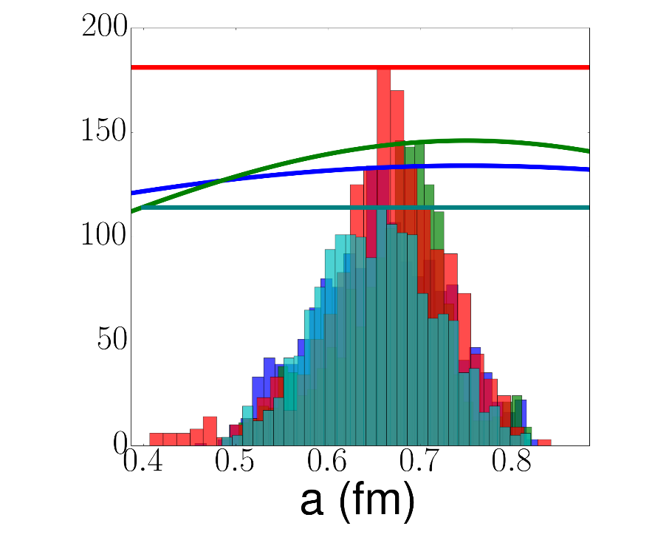
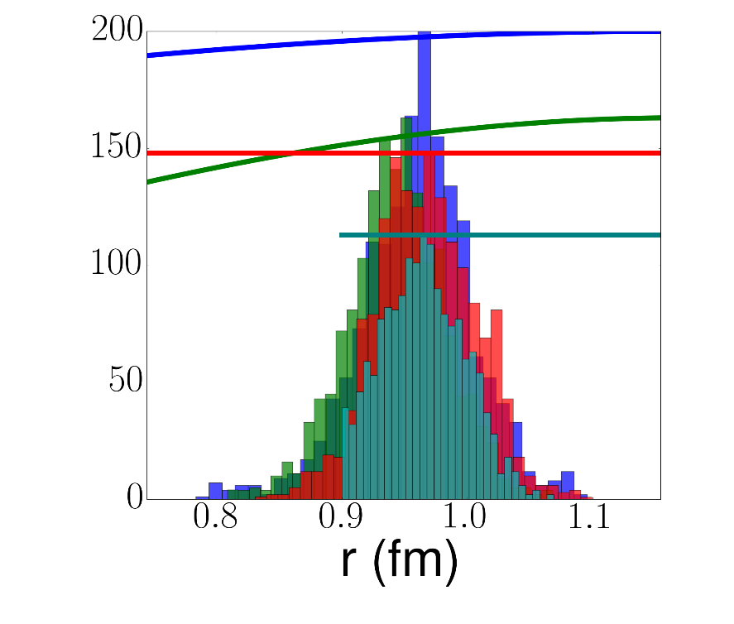
Verifying the Prior Shape Real Volume Parameters
⁹⁰Zr(n,n)⁹⁰Zr at 24.0 MeV
Large Gaussian
Medium Gaussian
Large Linear
Medium Linear
Parameter space scaling factor = 0.005
Notes:
First, we fix the step size in parameter space and look at various prior distributions using 90Zr-neutron elastic scatteing. We consider two Gaussians and two flat – or linear – priors. A large one that significantly further than the physical limits of these parameters, and a medium on which more or less covers the physical parameter space. Here, I show the posterior distributions for the real volume depth, radius, and diffuseness compared to the original prior distributions for each parameter. We can see that besides this sharp cut off with the medium linear prior, we get essentially the same distribution from each prior shape.

Slide 28
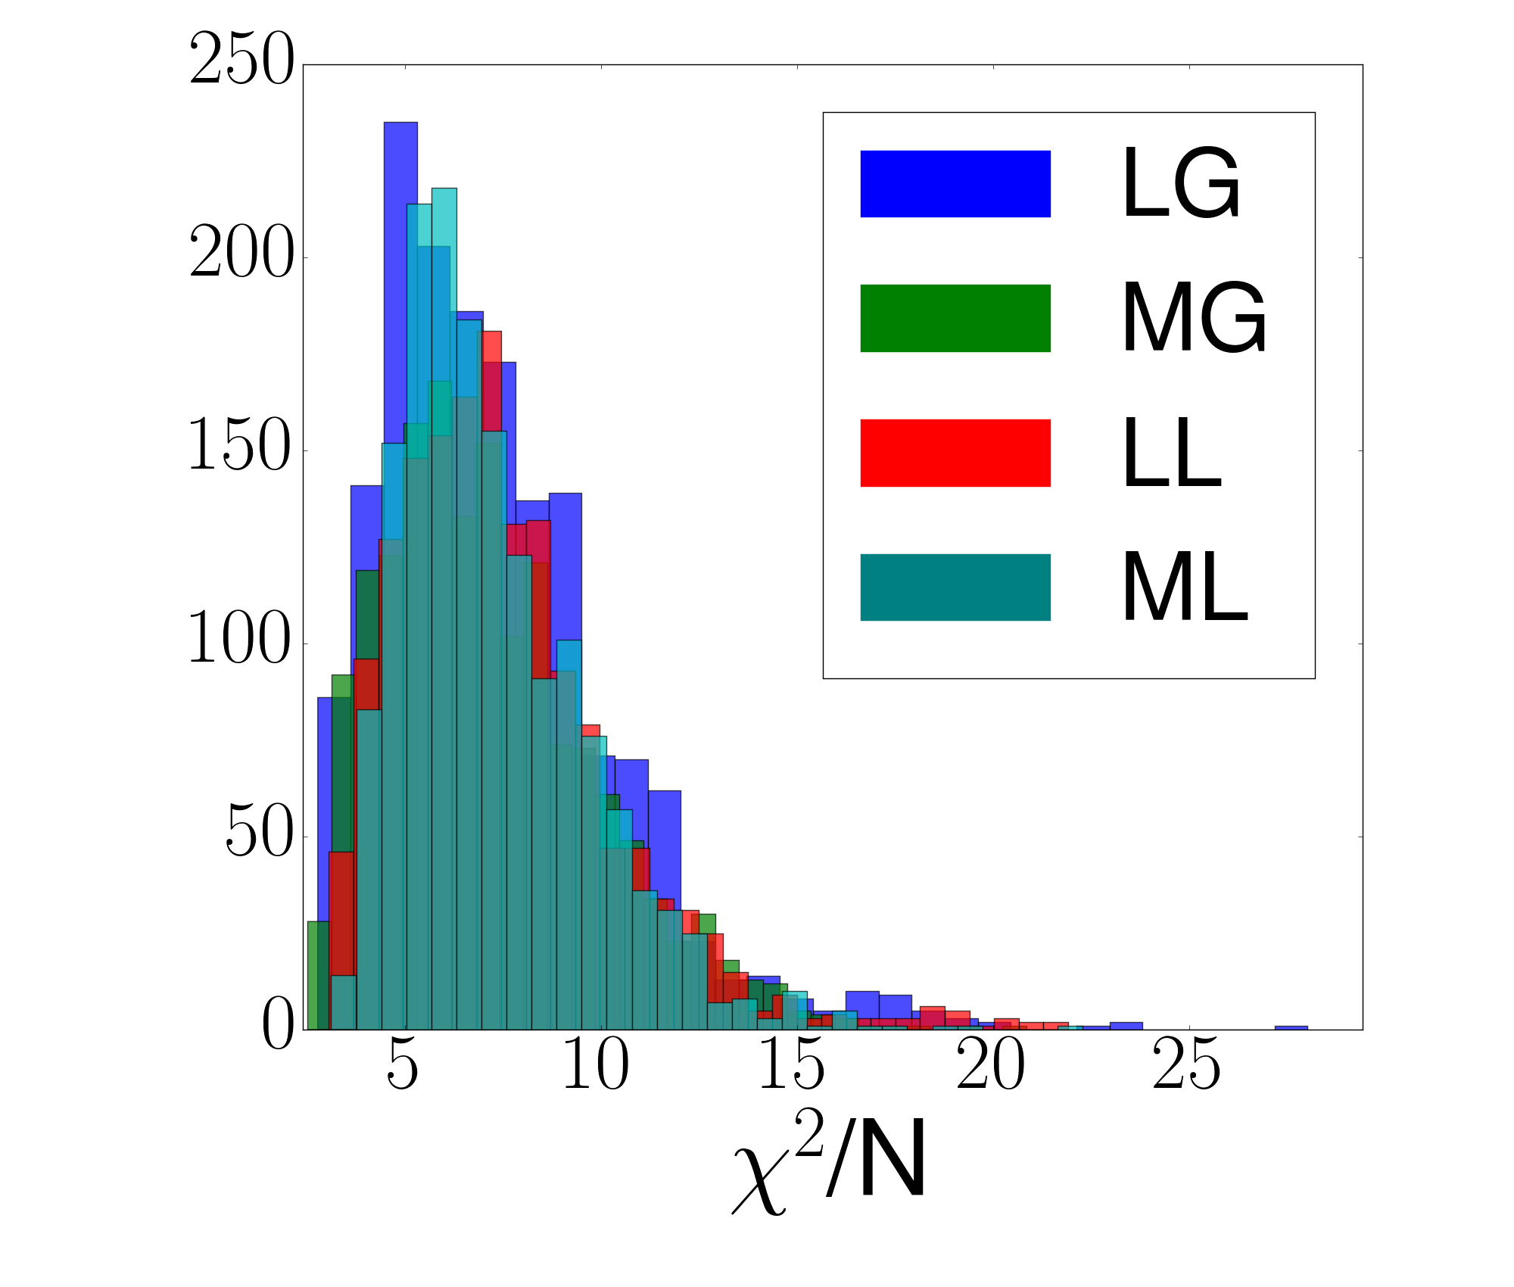
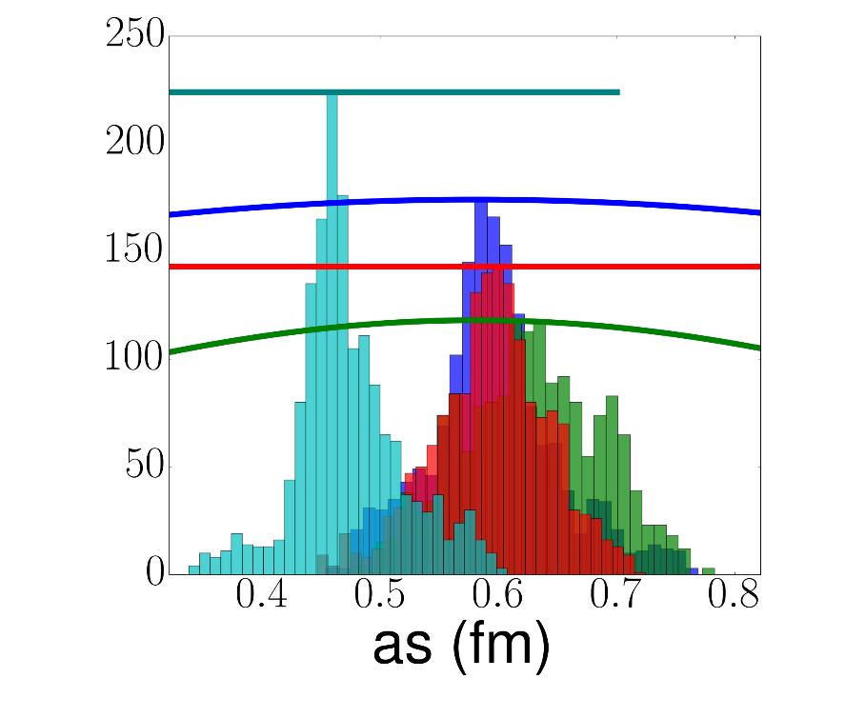
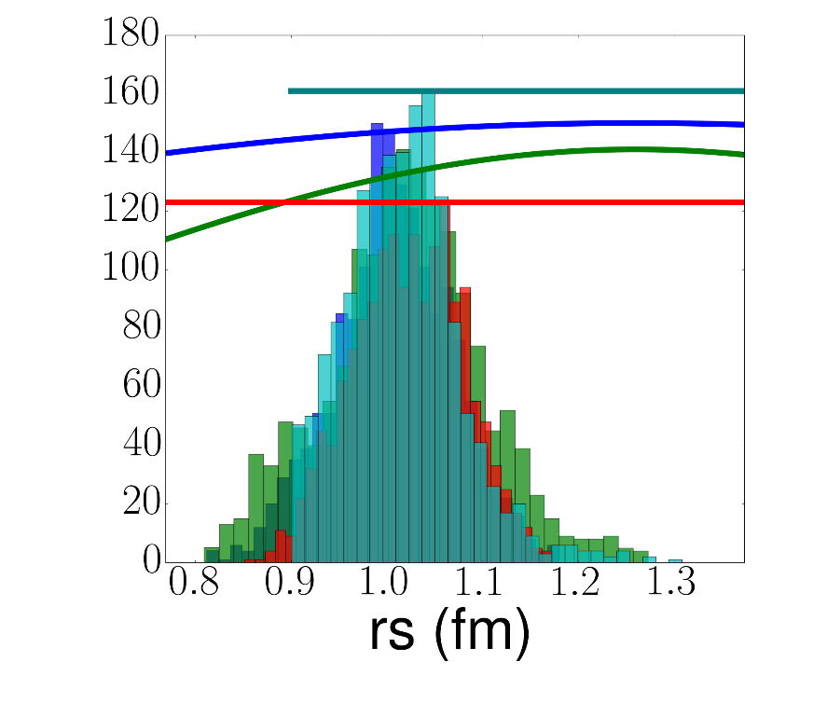
Verifying the Prior Shape Imaginary Surface Parameters
⁹⁰Zr(n,n)⁹⁰Zr at 24.0 MeV
Large Gaussian
Medium Gaussian
Large Linear
Medium Linear
Parameter space scaling factor = 0.005
Notes:
This is not necessarily true for the imaginary parameters where there are significant differences between the peaks. However, if we look at the chi^2 distribution that results from all of these calculations, we see essentially the same distribution regardless of the prior shape. This indicates that the correlations between the parameters may be more important than the parameters themselves.

Slide 29
Comparing Elastic Scattering ⁹⁰Zr(n,n)⁹⁰Zr at 24.0 MeV
95% confidence intervals
Data from: Nucl. Phys. A 517 301 (1990)
Notes:
We can further look at how these differences in the posterior distributions affect the calculation of the observables that we use to constrain the posteriors and any predicted observables. Here, I show 95% confidence intervals (represented by the colored bands, for the priors listed here) for the 90Zr-n elastic scattering compared to the data that was used to constrain the optical model parameters. The intervals are fairly well constrained by the data and do a good job reproducing the data. Which is unsurprising due to the relatively low chi^2 values. Also all of the priors provide essentially identical confidence intervals, which is maybe unsurprising given the similar chi^2 distributions.

Slide 30
Comparing Transfer Cross Sections ⁹⁰Zr(d,p)⁹¹Zr at 24.0 MeV
95% confidence intervals
DWBA where V_{d} ≈ 2V_{n}
Notes:
However, it is known that potentials that produce the same elastic scattering observables do not necessarily give rise to the same, say, transfer observables. We study this by calculating the 90Zr(d,p) cross section under DWBA (which I’ll discuss later in more detail) by taking the deuteron target interaction to be twice that of the neutron target interaction that was constrained by the data on the previous slide. (This is a good approximation since the neutron and proton optical potentials are nearly identical besides affects of the Coulomb barrier.) Again, we see very similar 95% confidence intervals for each of the prior distributions. The medium linear is somewhat smaller – probably due to the sharp cut offs in some of the parameters, and the medium Gaussian is somewhat larger – though mostly at the peak. The two large priors are essentially identical though. However, for the rest of this work, we focus on the Gaussian prior. There is nothing inherently wrong with the flat prior – though many people don’t like them because of the normalization – but in principle, we know more about our parameter space than just what values are physical. Global optical model parameterizations have been constructed by fitting to data over large portions of the nuclear chart, so we should put in that information about what parameters have been found to work well already. We have a preference for the Large Gaussian prior!

Slide 31
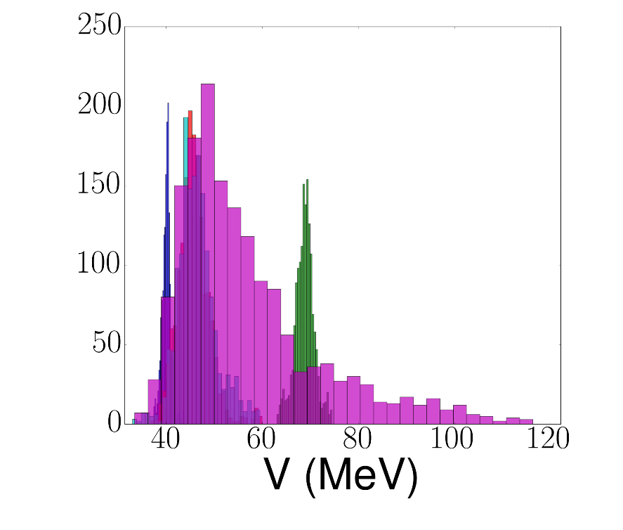
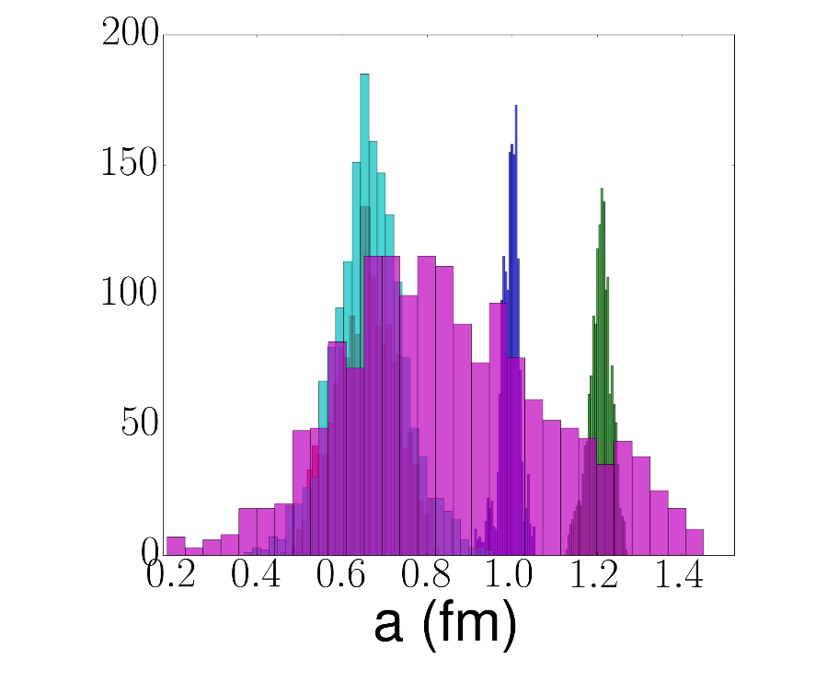
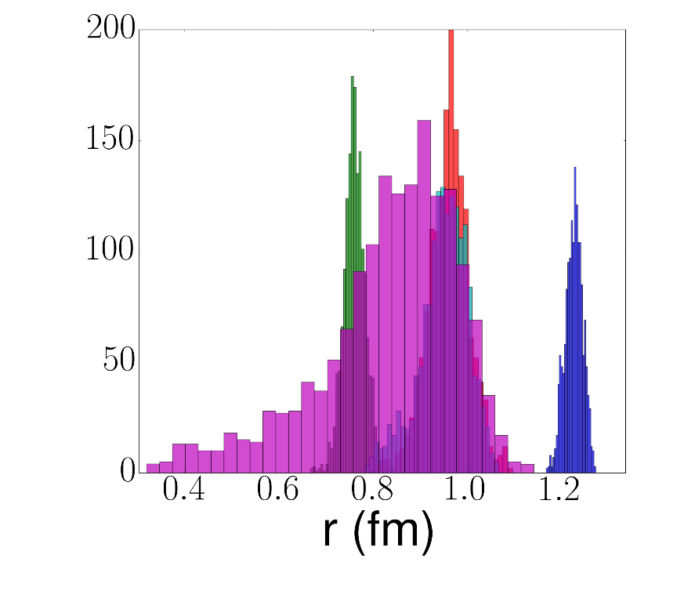
Verifying the Scaling Factor Using the Large Gaussian Prior
⁹⁰Zr(n,n)⁹⁰Zr at 24.0 MeV
0.001 0.002
0.005 0.01
0.05
The same trends are seen in the remaining parameters
Notes:
We can then keep the large Gaussian and look at the step size between the parameter draws. Too small of a step in parameter space and we won’t be able to explore all of it (can get stuck in a shallow, local minimum, too large and the sampling will take forever. We look at 5 step sizes, and we see just this. The smallest do not find the same minimum as the larger ones, so we’re not exploring the correct part of parameter space. The largest cannot constrain any of the parameters. So saying within the range of these red and teal steps is idea. (All of the other parameters showed this behavior as well.)

Slide 32
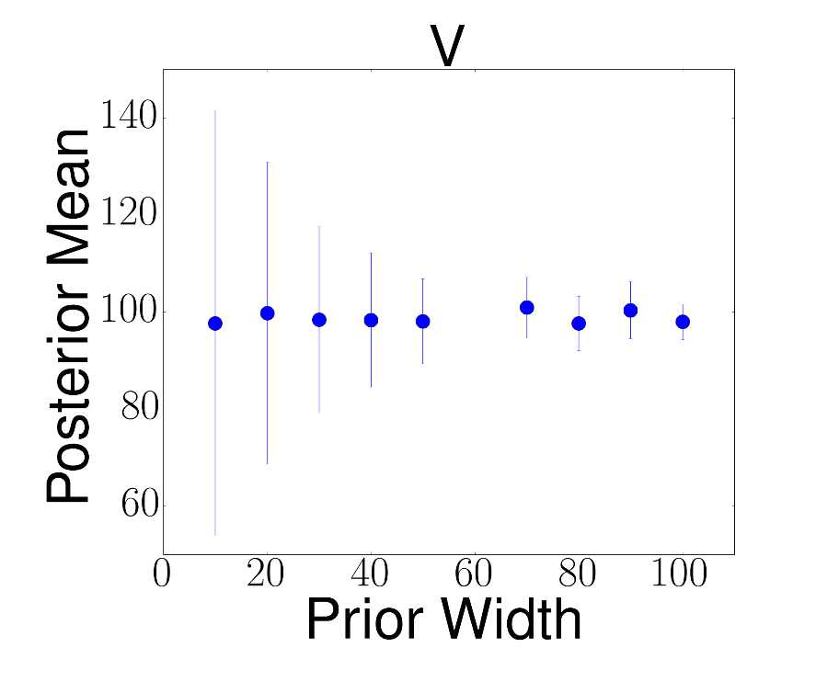
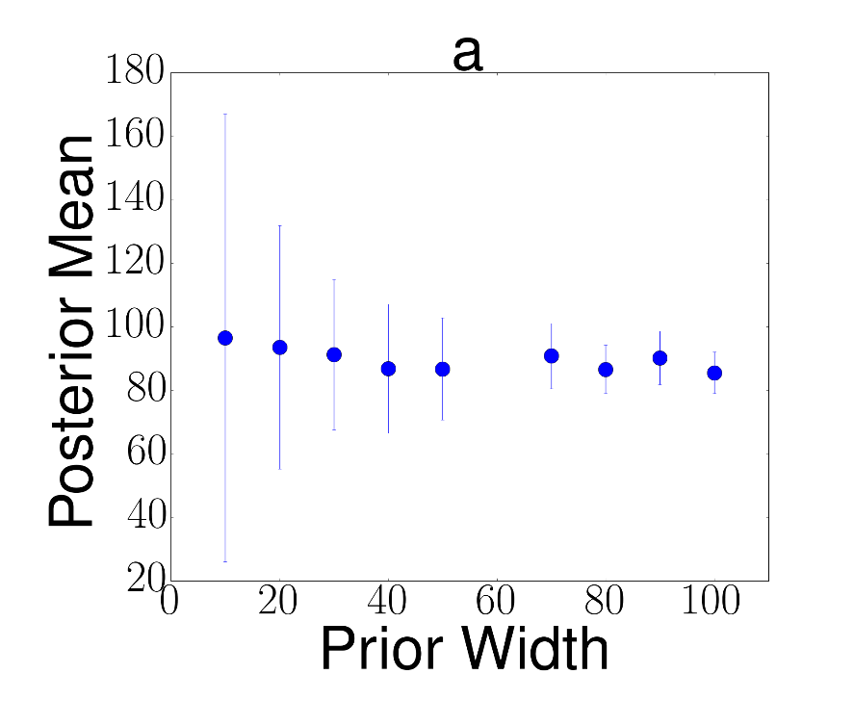
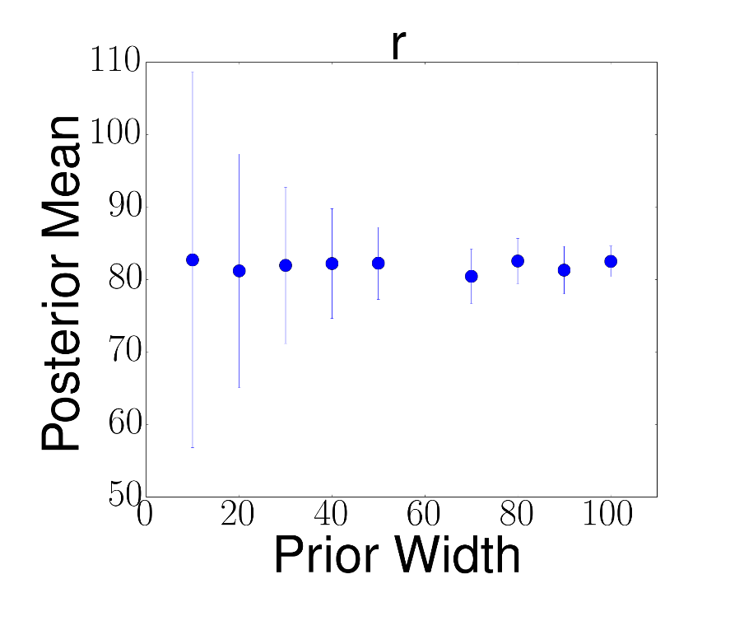
Systematically Studying Prior Widths with Gaussian Priors
⁹⁰Zr(n,n)⁹⁰Zr at 24.0 MeV
Notes:
We can finally systematically study the effect on the posterior means and widths of changing the width of the Gaussian prior. This is shown for the real volume parameters, prior width (given in terms of the percentage of the original optical model parameter value) compared to the resulting posterior mean – the mean is given as a percentage of the original parameter value (100% means that the value of the parameter didn’t change). The error bars show the width of the posterior as a percentage of the width of the prior. The first thing we notice is that the mean of the posterior is constant as the width of the prior increases. The posterior width also stays roughly constant – the shrinking error bars indicate that the posterior width is becoming a smaller fraction of the prior width as the prior width increases.

Slide 33
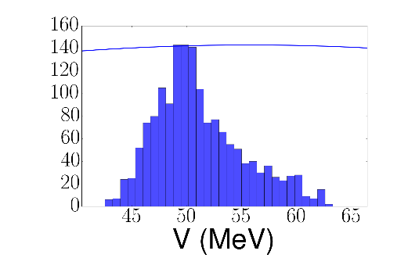
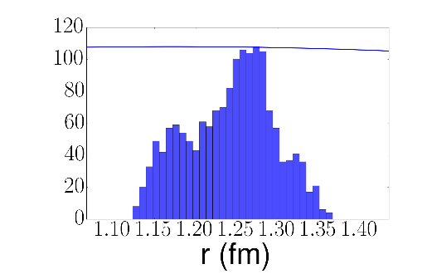
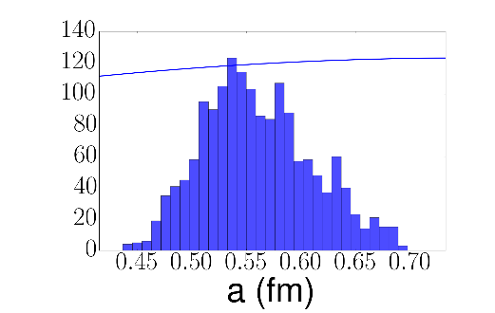
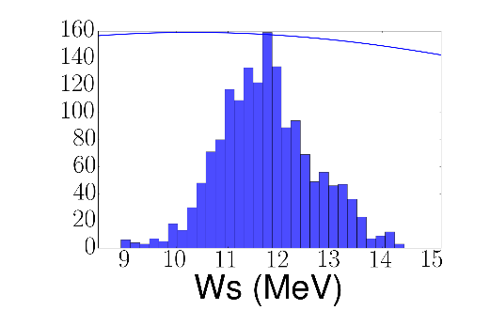
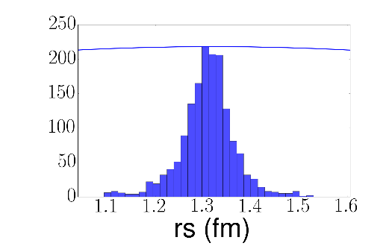
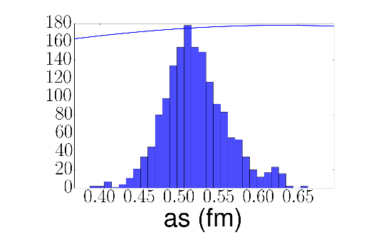
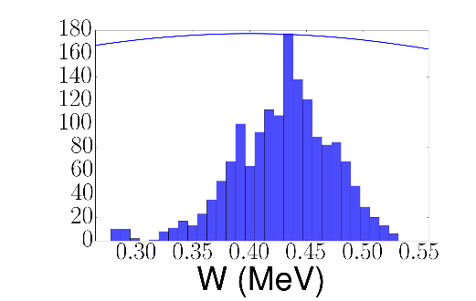
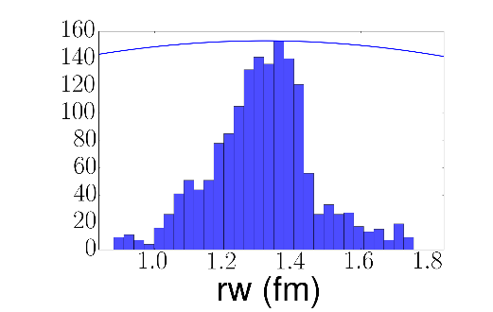
⁴⁸Ca(p,p) at 14.08 MeV Posterior Distributions
Real Volume
μ=51.15
σ=4.04
1.24
0.05
0.56
0.05
Imaginary Surface
11.75
0.92
1.31
0.06
0.52
0.04
Imaginary Volume
0.43
0.04
1.31
0.15
aw
Notes:
Can look at the posterior distributions for the 48Ca(p,p) at 14.08 MeV (this with the previous neutron scattering will construct the deuteron-target distorted wave). Again, we have well constrained parameters that are all centered on physical values. We do however notice that aw is missing. In this case, it was not allowed to vary with the rest of the parameters because when it was allowed to vary, it was not well-constrained. It took on values outside of the physical realm and outside of the range of the prior distribution. (For certain energies cannot constrain both surface and volume imaginary terms.)

Slide 34
⁴⁸Ca(p,p) at 14.08 MeV Angular Distribution
Data from: Nucl. Phys. A 188 103 (1972)
Notes:
Calculate the cross section again; again well-constrained and does a good job reproducing the shape of the data.

Slide 35
⁴⁸Ca(p,p) at 25.0 MeV Posterior Distributions
Real Volume
μ=53.49
σ=4.19
1.14
0.05
0.73
0.06
Imaginary Surface
6.82
0.55
1.33
0.07
0.59
0.05
Imaginary Volume
2.25
0.33
1.28
0.13
0.61
0.07
Notes:
Finally, we use 48Ca(p,p) elastic scattering at 25 MeV to constrain the potential for the outgoing proton scattering distorted wave. Technically, this should be an (A+1)-p interaction but the change in the optical potentials between A and A+1 is nearly inconsequential (~1%) that we can use them interchangeably. (It’s generally easier to find data for the A+p interaction than (A+1)+p.)

Slide 36
⁴⁸Ca(p,p) at 25.0 MeV Angular Distribution
Data from: Phys. Rev. C 33 1624 (1986)
Notes:
Finally the last cross section. The shape is very good and the bands are fairly narrow. Although the magnitude is a bit off at forward angles. This is controlled by the Coulomb radius, in the Coulomb potentials, which could in principle be fit as well, but in this work, it is left fixed for each case.

Slide 37
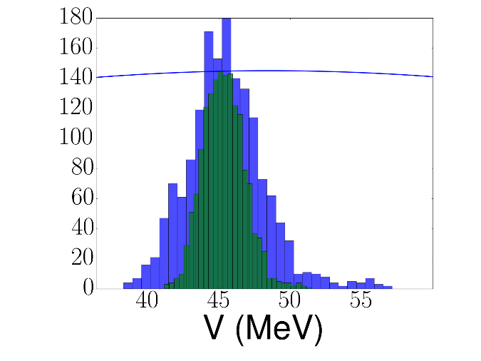
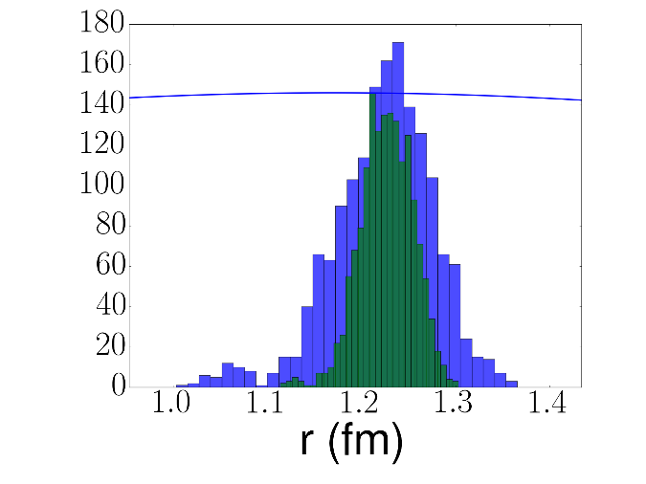
Studying Experimental Error Reduction
⁴⁸Ca(n,n) at 12.0 MeV
 | 10% Mean | 10% Width | 5% Mean | 5% Width
V | 45.51 | 2.74 | 45.35 | 1.47
r | 1.22 | 0.05 | 1.23 | 0.03
a | 0.68 | 0.06 | 0.68 | 0.03
Ws | 7.38 | 0.54 | 6.80 | 0.59
rs | 1.25 | 0.08 | 1.26 | 0.04
as | 0.29 | 0.04 | 0.31 | 0.03
W | 0.95 | 0.09 | 1.01 | 0.11
r | 1.21 | 0.12 | 1.13 | 0.15
a | 0.60 | 0.06 | 0.62 | 0.05
Real Volume
Notes:
We are further interested in understanding how the experimental precision of the data affects the uncertainty on our fits and resulting predictions. In principle, if data is meansured with less error, we should be better able to constrain our parameters, and therefore make more precise predictions. This is something that we focused on in this study. What I didn’t mention before is that the experimental data that we used to constrain all of the elastic scattering cross sections I showed, we assumed had a 10% error on it. Now, we can systematically cut all of those errors in half to study the resulting cross sections. First, we rerun the Monte Carlos, some of the results which are shown here (real volume parameters). There is a narrowing of the width of the posterior distributions but the mean in essentially identical. In the table, I show the means and widths for each of the parameters, for the Monte Carlo using 10% experimental errors and for the reduced 5% errors. (Specifically for 48Ca(n,n).) For all parameters, the means are very similar and the widths, for the most part, are smaller, though not necessarily halved. (This is true for the other two proton-target potentials.)

Slide 38
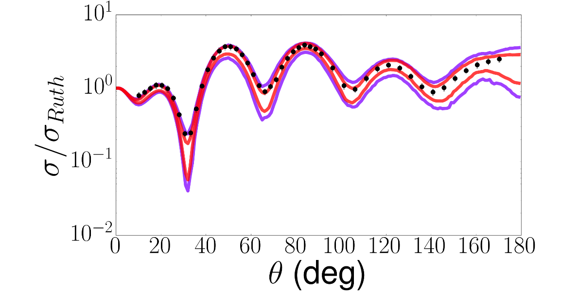
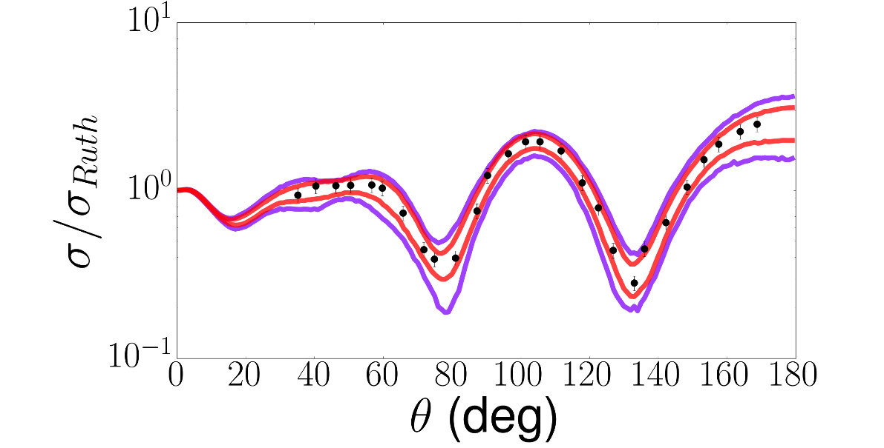
Error Reduction in the Elastic Cross Sections
⁴⁸Ca(n,n) at 12.0 MeV
⁴⁸Ca(p,p) at 14.03 MeV
Data from:
Phys. Rev. C 83 064605 (2011)
Nucl. Phys. A 188 103 (1972) Phys. Rev. C 33 1624 (1986)
⁴⁸Ca(p,p) at 25.0 MeV
Notes:
Then we can compare the 95% confidence intervals constrained using the 10% experimental errors (purple) and 5% experimental errors (red). In every case, the width of the confidence intervals are thinner, but definitely not halved.

Slide 39
Error Reduction for the Transfer Cross Sections ⁴⁸Ca(d,p)⁴⁹Ca(g.s.)
Comparison to data at 19.0 MeV
Data extracted from: A.M. Mukhamedzhanov, F.M. Nunes, and P. Mohr, PRC 77 051601 (2008)
Notes:
We can calculate the correspond transfer cross sections, shown here. Again, we do have a reduction in the width of the 95% confidence interval, but it’s not half the width. This is also seen in the percentage error, close to half but I think the numbers are 35% for the 10% and 25% for the 5%.

Slide 40
Summary of Results
⁹⁰Zr(d,n)⁹¹Nb @ 20.0 MeV
¹¹⁶Sn(d,p)¹¹⁷Sn @ 44.0 MeV
⁹⁰Zr(d,p)⁹¹Zr @ 22.0 MeV
²⁰⁸Pb(d,p)²⁰⁹Pb @ 32.0 MeV
Notes:
Over all, there were 5 cases that we studied this way. 90Zr(d,n), 90Zr(d,p) compared to data, 116Sn(d,p) and 208Pb(d,p). In all cases, we see this reduction of the confidence intervals when the experimental errors are reduced, but again not by 5%. It seems like there is a limit as to how good the data needs to be to make a difference in constraining the potential.

Slide 41
Complete Summary of Results
Studied five transfer reactions with ADWA and DWBA using 10% and 5% experimental errors
A reduction in the experimental error on the elastic scattering cross section reduces the width of the corresponding transfer cross section prediction
The theoretical errors are generally reduced when ADWA is used compared to DWBA
Notes:
Here is a complete list of all of the reactions that were studied, with the given reaction model and including either 10% or 5% experimental errors. (Angle of peak, xs value at peak, and percent errors for 95% and 68% confidence intervals.) Five reactions, where we generally see a decrease in the error when the experimental errors are reduced (but by less than 50%), and we for the most part see higher uncertainties in the dwba calculation.

Slide 42
Posterior Calculations (DWBA) ⁴⁸Ca(d,d) at 23.3 MeV
Imaginary Volume
Real Volume
Imaginary Surface
Notes:
So we can calculate the posterior distributions again, using both the 10% experimental errors and 5% experimental errors. Again, aw was not constrained by the data.

Slide 43
Angular Distributions (DWBA) ⁴⁸Ca(d,d) at 23.3 MeV
Data from: Nucl. Phys. A 533 71 (1991)
Notes:
Then we have the corresponding elastic scattering cross section for the two experimental errors. Here, we can also see that the data extends significantly less far than in the nucleon scattering case, where there was essentially full angular coverage.

Slide 44
Previous Statistical Study of Uncertainties
Previously used χ² minimization methods to create 95% confidence bands around a best fit and prediction
¹²C(d,d)¹²C @ 12 MeV
¹²C(d,p)¹²C @ 12 MeV
A.E. Lovell, F.M. Nunes, J. Sarich, S.M. Wild, PRC 95 024611 (2017)
Notes:
Besides having very nice results, we can also compare the Bayesian methods to a previous study that we did – published earlier this year, using frequestist statistics to model uncertainties. We used chi^2 minimization to find a best fit set of parameters then defined 95% confidence bands by pulling parameter sets from a multivariate Gaussian defined around the best fit set. Get the 95% bands on the best fit (fitted elastic scattering data), and then use these parameter sets to make predictions (e.g. transfer)

Slide 45
Comparison of Fitting Methods
¹²C(d,d)¹²C @ 12 MeV
¹²C(d,p)¹²C @ 12 MeV
A.E. Lovell, F.M. Nunes, J. Sarich, S.M. Wild, PRC 95 024611 (2017)
Notes:
In this work, we compared this typical chi^2 minimization to minimization using a modified chi^2 function that takes into account the correlations between angles within the model. Again, created CB and propagated them. Then we could directly compare the resulting cross sections, both fitted and predicted. For these, though, we only constrained the incoming elastic scattering potential (and only used DWBA for the transfer cross sections).

Slide 46
Comparison with Frequentist Methods
Work done by Garrett King
System | Frequentist | Bayesian
⁴⁸Ca(d,p)⁴⁹Ca | 21.79% | 35.76%
⁹⁰Zr(d,p)⁹¹Zr | 13.29% | 47.62%
¹¹⁶Sn(d,p)¹¹⁷Sn | 68.23% | 121.77%
²⁰⁸Pb(d,p)²⁰⁹Pb | 33.84% | 37.84%
Preliminary
⁴⁸Ca(n,n) @ 12.0 MeV
Notes:
We’ve had an undergrad working with us for the past 4 or 5 months who has been using these same techniques but looking at the same reactions and models as we did with the Bayesian. Not only is this a more complete study than we did previously – since we’re looking at two reaction models and constraining all elastic channels – we can also directly compare the chi^2 fitting and the Bayesian methods. Here are some preliminary results from that study compared to what I showed you earlier. Take a look at the same elastic scattering cases (Garrett’s work, and what I showed you earlier), and a comparison of the percent errors (at the peak of the transfer cross section) for my work and for Garrett’s work. These are just preliminary, but we do see that percent error on the confidence intervals can be significantly larger than those from the confidence bands. This is still very much ongoing work, and I am extremely excited to see where it leads.

Slide 47
Outlook: Model Uncertainties
Evidence – marginal distribution of the data given the likelihood and the prior

Slide 48
Outlook: Including the Right Information
We want to understand if the data we are using to constrain the potentials is enough to constrain all of the parameters within our models
Use Principle Component Analysis (PCA) to study this – understand how much information is actually contained in elastic scattering (do we need total cross sections, radii, other channels, etc.?)
E. Sangaline and S. Pratt, arXiv:1508.07017v2 [nucl-th] 4 Oct 2015

Slide 49
Distorted Wave Born Approximation (DWBA) For Transfer
r
Working in the post form
R
R
r
B
Exact T-matrix
A
For (d,p):
v – neutron
b – proton
A - target
DWBA Approximation
I.J. Thompson and F.M. Nunes, Nuclear Reactions for Astrophysics, (Cambridge University Press, Cambridge, 2009)

Slide 50
Adiabatic Wave Approximation (ADWA)
r
Exact equation
R
Hamiltonian internal to the projectile (d)
with
r slow compare to R
Good approximation to solve
This three-body wave function goes into the T-matrix
I.J. Thompson and F.M. Nunes, Nuclear Reactions for Astrophysics, (Cambridge University Press, Cambridge, 2009)

Slide 51
More Details About Cross Section Calculations
I.J. Thompson and F.M. Nunes, Nuclear Reactions for Astrophysics, (Cambridge University Press, Cambridge, 2009)

Slide 52
Verifying the Prior Shape

Slide 53
Verifying the Scaling Factor Using the Large Gaussian Prior

Slide 54
Comparing the Widths

Slide 55
Cannot constrain aw
aw

Slide 56
Nucleon Chi^2 Distributions
⁴⁸Ca(n,n) @ 12.0 MeV
⁴⁸Ca(p,p) @ 14.03 MeV
⁴⁸Ca(p,p) @ 25.0 MeV
⁴⁸Ca(d,d) @ 23.2 MeV

Slide 57
Error Comparisons ¹²C(n,n) at 12.0 MeV

Slide 58
Error Comparisons ¹²C(p,p) at 14.03 MeV

Slide 59
Error Comparisons ¹²C(p,p) at 25.0 MeV

Slide 60
Error Comparisons ¹²C(d,d) at 23.2 MeV

Slide 61
Reduction Factors

Slide 62
Nonlinear Least Squares
Have n observable pairs (d_{i},θ_{i}) that are linked by a true function, µ(θ_{i}), such that:
In not knowing the true function, we create a model, m(x,θ_{i}), to describe the data
In fitting the model to the observables, the goal is to minimize the residuals
For uncorrelated observables
Best fit set of parameters
Minimizing the residuals
S.M. Wild, J. Sarich, N. Schunck, J. Phys. G: Nucl. Part. Phys. 42 034031 (2015)
Notes:
How do we do this? We have n observable pairs, in our case differential cross sections at a given angle that are connected by some true function, mu. The data are distributed normally around this true function with some variation – the experimental errors. However, we don’t know this true function, so we create a model with a set of free parameters, hoping that there is some perfect set of parameters such that m(x*, theta) = mu(theta). In fitting to the data, what we are trying to do is minimize the residuals (the difference between the theory and the data). For uncorrelated observable pairs, this leads us to our familiar chi square equation. In performing this minimization, we assume that the resulting residuals also be normally distributed – Sigma is the matrix with the experimental errors squared on the diagonals.

Slide 63
Defining Confidence Bands
Minimize the residuals
Variation around the best fit are described by a normal distribution
Pull 200 sets from this distribution and run them through the model
Create 95% confidence bands by removing the top 2.5% and bottom 2.5% of the calculations at each angle
Notes:
This is a very interesting way to look into our model in more detail, but what we are also interested in is putting confidence bands around our best fit calculation. Once we have our minimization, we make sure that our residuals are Gaussian. The variations around the best fit are modeled by this normal distribution – this Cp is the same covariance matrix that was defined two slides ago, except that it is scaled to take into account the “goodness” of the fit. S2 is just the chi square value divided by the number of degrees of freedom (number of points fitted minus the number of parameters fit). We pull 200 parameter sets from around this distribution and run them through our model. From these outputs, the top 2.5% and bottom 2.5% of the calculations are removed at each angle, which defines the 95% confidence bands.

Slide 64
Correlations in the Model
22°
27°
32°
42°
48°
53°
Elastic Differential Cross Section
64°
75°
85°
95°
Angular correlations of 200 parameter pulls through the model
Distribution of cross section values at the experimental angles
105°
114°
124°
134°
143°
152°
161°
22°
32°
48°
64°
85°
105°
124°
143°
161°
27°
42°
53°
75°
95°
114°
134°
152°
S.M. Wild, Private Communication, October 2015
I.J. Thompson and F.M. Nunes, Nuclear Reactions for Astrophysics, (Cambridge University Press, Cambridge, 2009)
Notes:
Well, the first thing we remember is our model is correlated – as we can see even if we look at a simple expression for the elastic differential cross section. We had assumed in our previous discussion that each of our angles was independent from the previous one – which is not true. And this doesn’t get any better when the complexity of our model is increased – including coupled channel calculations and the like. We can see the correlations that our model causes through this pictorial version of the model covariance matrix. For each pair of experimental angles, a scatter plot is constructed for the values of the differential cross sections at those angles; the histograms show the distributions of these differential cross section values at each angle. Scatter plots are mirrored on each side of the histograms. If these red curves, which encircle a majority of the points on each scatter plot, where all circles, the model would be fully uncorrelated. This is clearly not the case, so how do we take this into account.

Slide 65
Including Correlations within the Model
Previously: Uncorrelated Model
Instead: For a Correlated Model
Data and residuals are normally distributed
With covariance matrix
Leads to the minimization function
Model is also normally distributed
Residuals then have the distribution
With covariance matrix
Leads to the minimization function

Slide 66
Parameter Correlations
It is natural to construct a matrix defined by the curvature around the best fit set of parameters
Transformation to the correlation matrix shows the couplings between parameters
Diagonal Elements are ONE
Parameters are fully correlated with themselves
Off-diagonal elements range from ZERO to ONE
Zero means no correlation between parameters
Parameter Covariance Matrix
Jacobian
G.A.F. Seber and C.J. Wild, Nonlinear Regression, John Wiley & Sons, New York (1989)
Notes:
We can examine the parameter space around our minimum by constructing a covariance matrix, defined through the Jacobian – which is the matrix of the derivatives of the residual vector. To look at the correlations between our parameters, this parameter covariance matrix is transformed to a correlation matrix, as defined here. The diagonal elements of this matrix are 1, and the off diagonal elements range from 0 to 1, where zero means no correlation and 1 is fully correlated.

Slide 67
Correlations Between Parameters
Highly Correlated Parameters
Largely Independent Parameters
Notes:
We can see this pictorially by drawing contour plots of constant chi square. To do this, we fix all of our free parameters at the best fit and allow only two parameters to vary on a grid around the best fit. This way we can see what the region around our parameter space looks like. For highly correlated parameters, such as shown here, both parameters much be varied together in order to stay in a region of low chi square, while for independent parameters, one can be varied without the other while still remaining in a minimum.

Slide 68
Sometimes Assumptions Do Not Hold
Pull from levels of constant chi square (instead of Gaussian)
One standard deviation
Comes from a Taylor Expansion around the best fit set of parameters
Contours are not elliptical – assumption of Gaussian distribution fails

Slide 69
Comparisons of Fits ¹²C(n,n)¹²C and ¹²C(n,n’)¹²C($2_{1}^{+}$) at 17.29 MeV
Elastic
Inelastic
Preliminary
Notes:
We can compare fits. Differential cross section as a function of angle where the black is the previous (uncorrelated best fit) and the red gives the new fit using this correlation matrix. You can see the difference in fitted parameters as well as chi square/N. We can already see that even though it looks, at least to me, that the fit is farther away from the data than previously, we have a better chi square value, as well as having a curve that better fits the shape of the data. Taking into account correlations also means that once your calculation drops below the data, it is more likely to stay there.

Slide 70
Correlations in Parameters – ¹²C(n,n)¹²C
Parameters are highly correlated
Not all may be independent

Slide 71
Error Comparison for ⁴⁸Ca(d,d)⁴⁸Ca E=23.2 MeV
W.W. Daehnick, J.D. Childs, and Z. Vrcelj, Phys. Rev. C 21 2253 (1980)
J.M. Lohr and W. Haeberli, Nucl. Phys. A 232 381 (1974)
Notes:
We can compare these new error band calculations with those we used to make – which compared two different parameterizations. These are shown in black, compared to the error bands that we’ve computed. These types of comparisons cannot give us a reliable way to put error bands on our calculations.

Slide 72
Error Comparison for ⁴⁸Ca(d,p)⁴⁹Ca E=23.2 MeV
W.W. Daehnick, J.D. Childs, and Z. Vrcelj, Phys. Rev. C 21 2253 (1980)
J.M. Lohr and W. Haeberli, Nucl. Phys. A 232 381 (1974)
Notes:
This is the same for the transfer calculation. Once again, the best fit calculation doesn’t even fall with the two parameterizations that we are comparing.

Slide 73
Contour Plots for ¹²C(n,n)¹²C Without Model Correlations

Slide 74
Contour Plots for ¹²C(n,n)¹²C Without Model Correlations

Slide 75
Fitting with sfresco
sfresco (www.fresco.org.uk) comes with MINUIT implemented for minimizing an uncorrelated χ² function
Our version of sfresco has POUNDERS (derivative-free minimizer) implemented – thanks to Jason Sarich
Separate programs (written by J. Sarich and A.E. Lovell) calculate the Jacobian, correlation matrices, as well confidence bands
A second version the code, csfresco, has recently been revised to include model correlations – and minimize the correlated χ² function

Slide 76
Model Correlations Affect the Confidence Bands
Without Model Correlations
With Model Correlations

